Slide 1
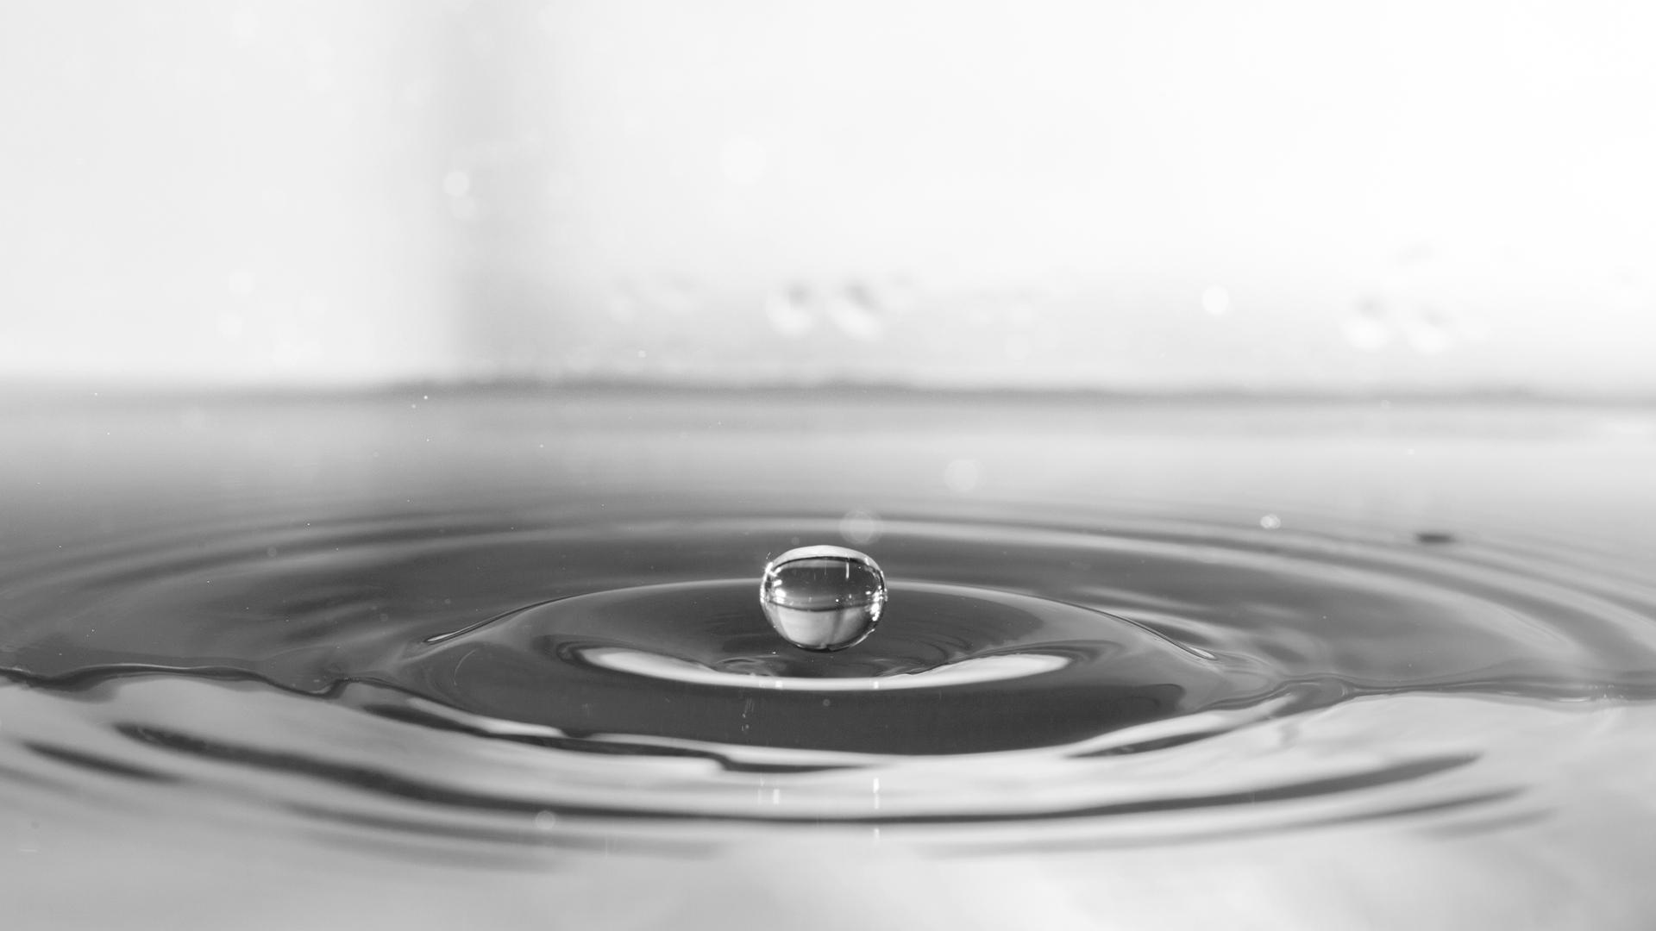
MISSION RIVER
BY TEAM HACK_IN

Slide 2
01
Introduction
02
problems
03
The idea
contents
04
Problems solved
05
Impact and other aspects
06 validity and relevamce

Slide 3

introduction
Our earth is covered 71% by water out of which only 0.3 % is usable for domestic and industrial purposes.
The population growth of humans has strained these resources of water.
Billions of people living in sub Saharan Africa, South Asia and Latin America are exposed to water borne diseases and deformities due to consumption of water consist of heavy metals and other minerals.
Humans and industries are both severely affected due to excess proportion of minerals present in water.
Our idea which is consist of an web that will help industries, authorities and communities to identify the hazardous chemicals and all other elements, its possible source and remedy.

Slide 4
MARINE LITTER
pollution
PROBLEMs
extinction
temperature
People are sometimes careless and throw rubbish directly into rivers.
Dirty water containing chemicals is put back in the river.
Human activities affect marine ecosystems as a result of pollution, which all impact on the marine life
Raising the temperature of the water lowers the level of dissolved oxygen and upsets the balance of life in the water

Slide 5
The idea
The idea
Our idea is consist of an web to provide user friendly and interactive data.
First part of this project is an web (through url) which will be used to see data about heavy metals, minerals and other trace elements from the sample water of River.
Second part of this project will show the data to the user which can be used for further analysis.
The web will also provide database tracing of possible sources of pollution in nearby areas using geographical map (NASAEARTH).
To analyze the source of pollution we are also using NASA earth explorer as it will provide us the map based data of the location user searched for.
It will also share possible remedies to the user and will inform about less polluted sources in area.

Slide 6
PROBLEM SOLVED
This idea will help the user to understand and analyze the quality of water from ones source.
This data can be used by industries to check the quality of water before using its manufacturing process.
Authorities can also use this device to understand the quality of water in their area and formulate a solution which will help the community.
Also an individual user can use it to check the quality of water and communicate with their respective authority if any deviation in quality of water.
It will be easy to use, cost effective and will provide real time data.

Slide 7
Impact and other Aspects
IMPACT : This idea will impact from industrial to administrative level of society. It will affect the health of both humans and machineries thus increasing their life. It will also enlighten people about the quality of water from their surrounding sources and prompt them to take action for I its improvement.
CREATIVITY : Element tracing devices already being use in petroleum industries. Our idea will be an improvement as it will help the community to understand the quality of water and source of pollution by the use of a very interactive and user friendly app.

Slide 8
Validity and Relevance
VALIDITY : Our idea is totally valid and feasible because devices with some similarities are already being used in industries. It can easily work in real world as the device is simple, portable and the app can be accessible in most of the devices.
RELEVANCE : Our idea will empower the user to analyze the quality of water which is key element of healthy life. It is a part of complete solution against combating water pollution and its affect on human body and machinery. The app will provide data in user friendly form which can be easily use by user.

